Slide 1




MAT-gpt
Let’s start!
Presented by VOYAGER

Slide 2

welcome!
We are thrilled to have you here today as we present our innovative project, MATgpt, designed to simplify math and empower users with AI-driven solutions. Let's explore the journey and vision behind MATgpt together!
Let’s begin!

Slide 3

Our vision
Our vision is to simplify math learning through innovative AI tools, empowering students, educators, and professionals worldwide to build a platform that evolves with user needs and advancements in AI.

Slide 4




Meet the team
Tamzid Ahmed Pallab
2125051103
Mehedi Hasan Sipon Id: 2125051082
Robiul Islam Jubaer 2125051097
Md. Hasib 2125051076

Slide 5
Introduction
.
MATgpt is an AI-powered chatbot designed to solve mathematical problems.
Focused on simplifying and automating complex calculations.
Combining the latest AI technologies to enhance learning and productivity.
To provide accessible and reliable math solutions for everyone. Implementing Python-based AI algorithms and natural language processing (NLP) for accurate math problem-solving.

Slide 6

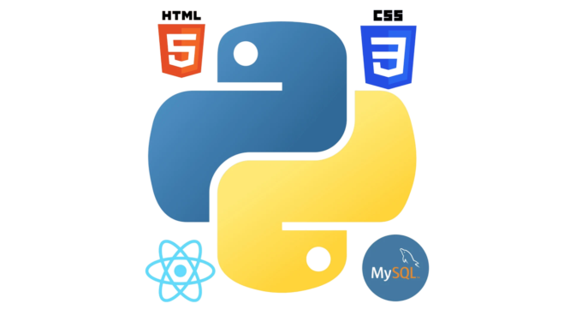

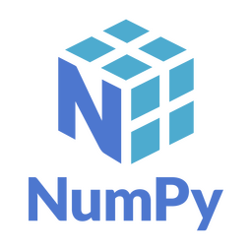
Used Language:
Front-end: HTML, CSS
Back-End: Python(Django farmwork)
Database: MySQL
Requirement:
Internet
Web-Browse
Platform: Web-based.
AI Models & libraries: GPT-based language models for NLP. NumPy,

Slide 7

Features

Slide 8
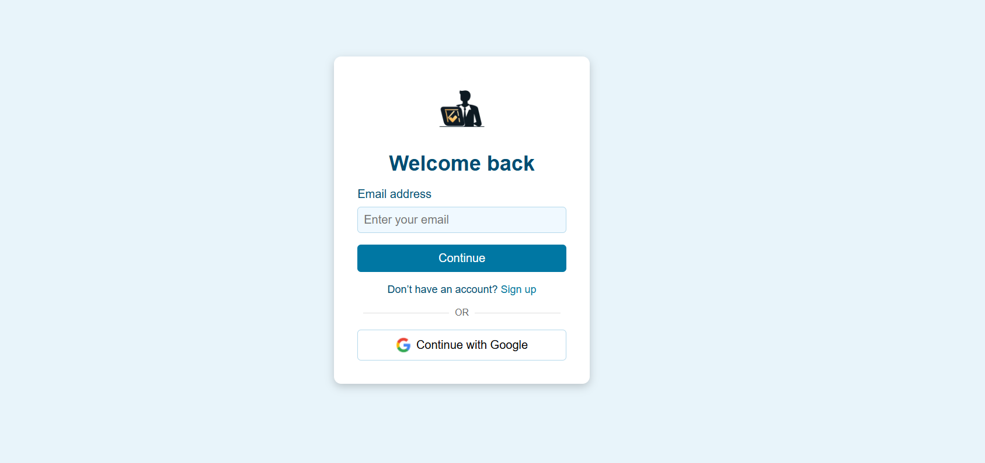

Slide 9
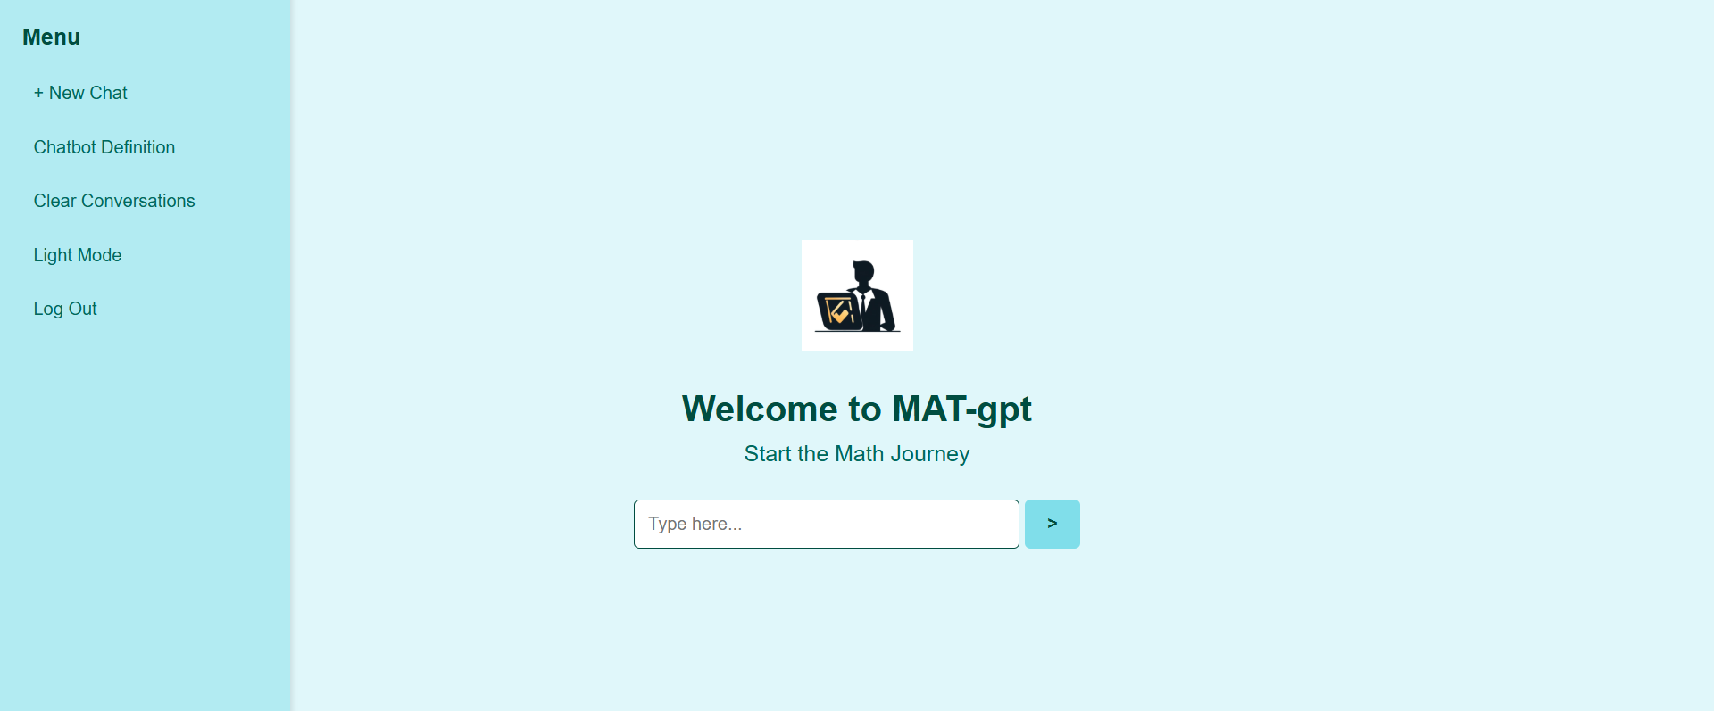

Slide 10
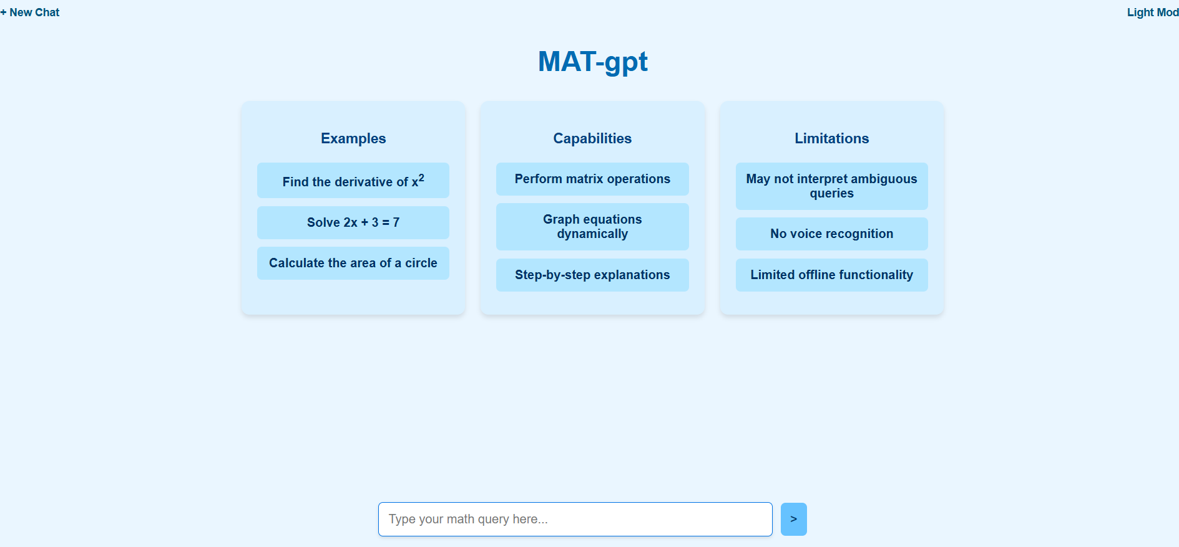

Slide 11

Limitations :
Incomplete Development:
The backend chatbot functionality is still under development, limiting real-time usage.
Limited Problem Types:
Currently focused on solving basic and intermediate math problems. Advanced problem-solving (e.g., differential equations, proofs) is yet to be integrated.
Web Interface Constraints:
The web page is in progress.
Accuracy Challenges:
AI accuracy depends on the training data, and errors may occur for complex or ambiguous queries.
Platform Dependency:
Fully web-based now, with no offline or mobile app options at this stage.

Slide 12
Roadmap :
1. Complete backend integration by 2 weeks.
2. Implement advanced features like step-by-step explanations.
3. Enhance user interface and experience with dynamic designs.
4.Full deployment and beta testing by 6 months.

Slide 13
Conclusion :
MATgpt aims to revolutionize math problem-solving by using AI to simplify complex calculations and enhance learning. While still in development, it reflects our commitment to creating an intuitive and accessible platform for diverse users. Thank you for your time, and we look forward to your feedback to help improve and grow this project.

Slide 14
Thank
you!
Don’t hesitate to contact us
VOYAGER

